Slide 1
Disk Structure
Disk drives are addressed as large 1-dimensional arrays of logical blocks, where the logical block is the smallest unit of transfer.
The 1-dimensional array of logical blocks is mapped into the sectors of the disk sequentially:
Sector 0 is the first sector of the first track on the outermost cylinder.
Mapping proceeds in order through that track, then the rest of the tracks in that cylinder, and then through the rest of the cylinders from outermost to innermost.

Slide 2
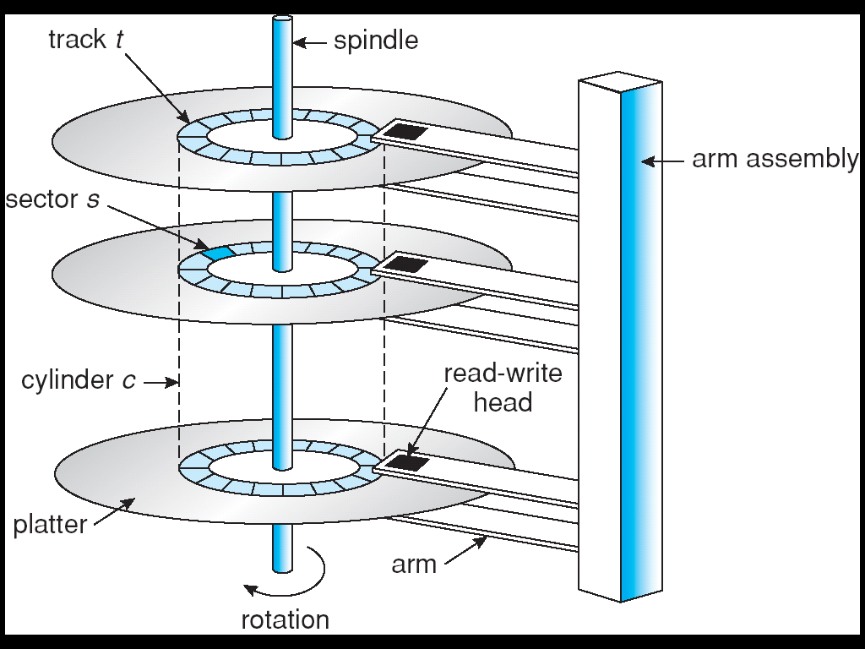
Moving-head Disk Mechanism
Notes:
2

Slide 3
Disk Scheduling
The operating system is responsible for using hardware efficiently — for the disk drives, this means having a fast access time and disk bandwidth.
Access time has two major components
Seek time is the time for the disk are to move the heads to the cylinder containing the desired sector.
Rotational latency is the additional time waiting for the disk to rotate the desired sector to the disk head.
Minimize seek time
Seek time ≈ seek distance
Disk bandwidth = the total number of bytes transferred/ total time between the first request for service and the completion of the last transfer.

Slide 4
Disk Scheduling (Cont.)
Several algorithms exist to schedule the servicing of disk I/O requests.
We illustrate them with a request queue (0-199).
98, 183, 37, 122, 14, 124, 65, 67
Head pointer 53

Slide 5
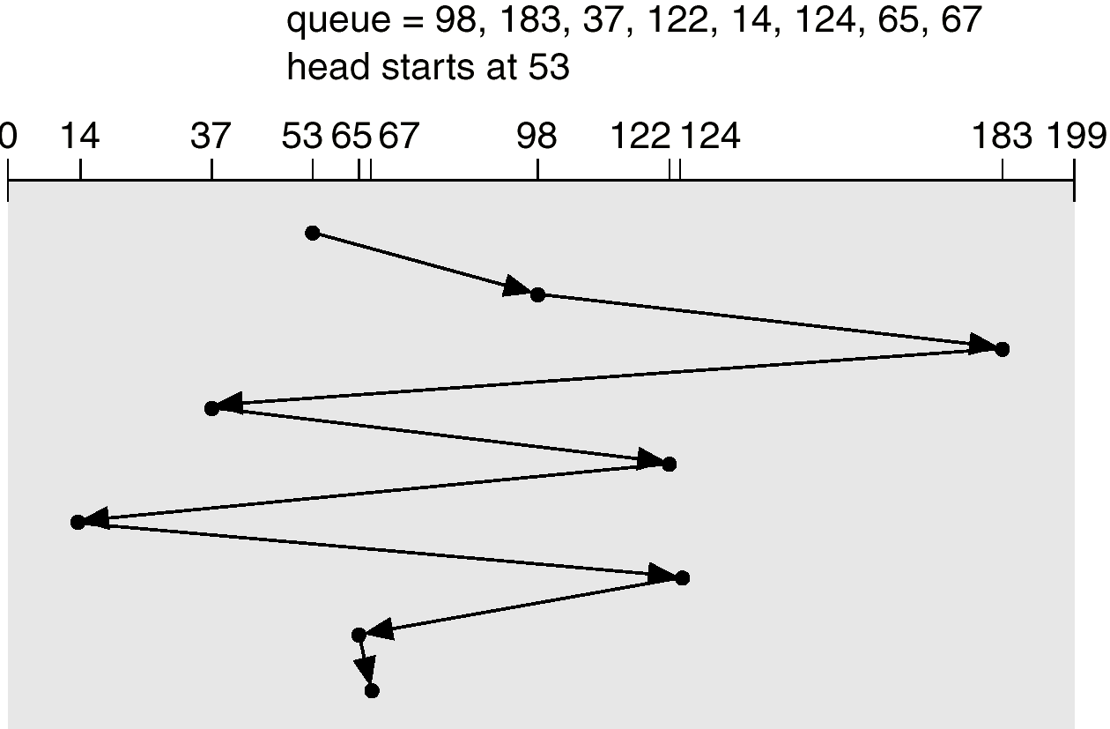
FCFS
Illustration shows total head movement of 640 cylinders.
|53-98|+|98-183|+|183-37|+|37-122|+|122-14|+|14-124|+|124-65|+|65-67|
=45+85+146+85+108+110+59+2 = 640

Slide 6
SSTF
Selects the request with the minimum seek time from the current head position.
SSTF scheduling is a form of SJF scheduling; may cause starvation of some requests.
Illustration shows total head movement of 236 cylinders.

Slide 7
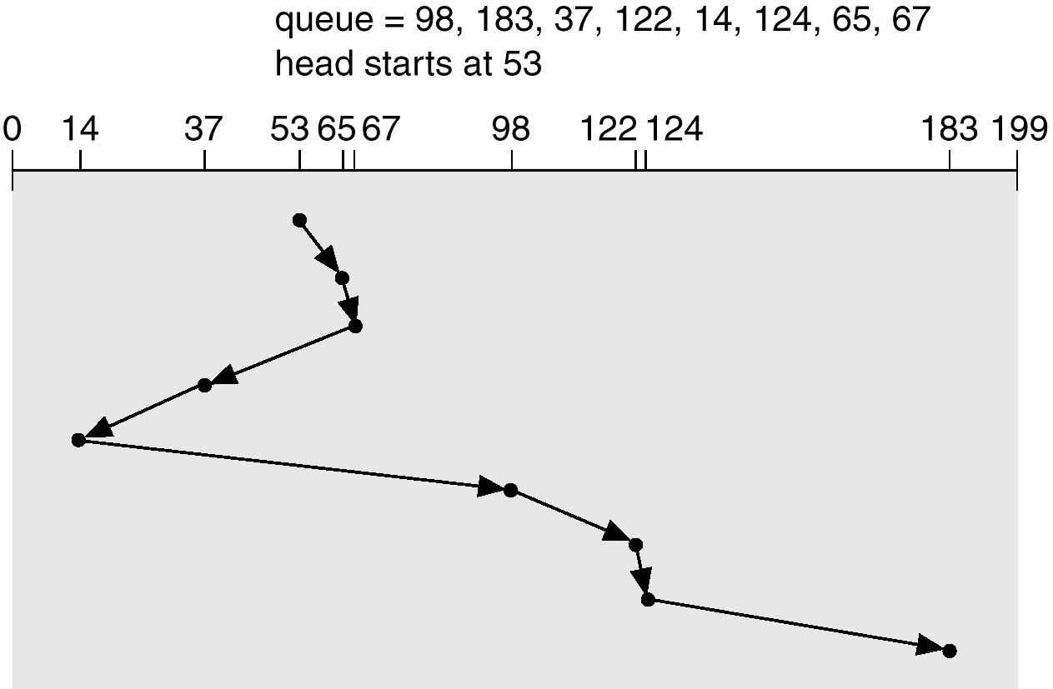
SSTF (Cont.)

Slide 8
SCAN
The disk arm starts at one end of the disk, and moves toward the other end, servicing requests until it gets to the other end of the disk, where the head movement is reversed and servicing continues.
Sometimes called the elevator algorithm.
Illustration shows total head movement of 208 cylinders.

Slide 9
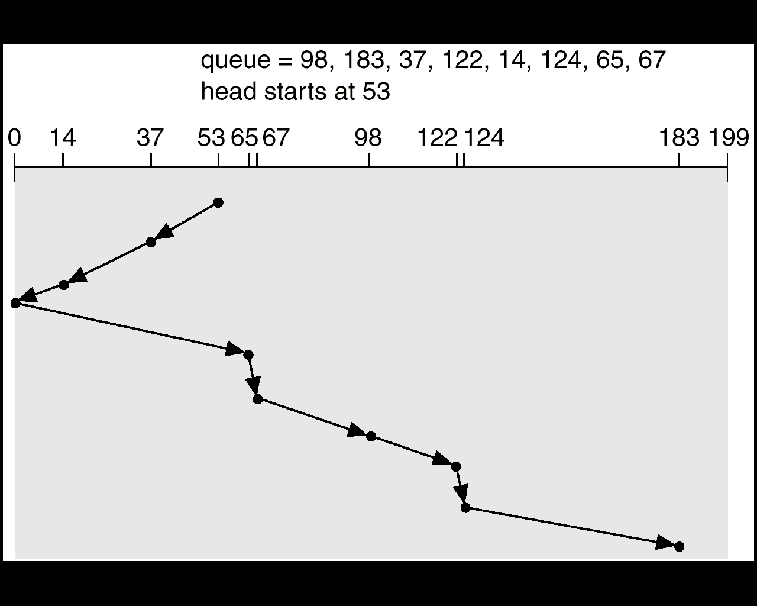
SCAN (Cont.)

Slide 10
C-SCAN
Provides a more uniform wait time than SCAN.
The head moves from one end of the disk to the other. servicing requests as it goes. When it reaches the other end, however, it immediately returns to the beginning of the disk, without servicing any requests on the return trip.
Treats the cylinders as a circular list that wraps around from the last cylinder to the first one.

Slide 11
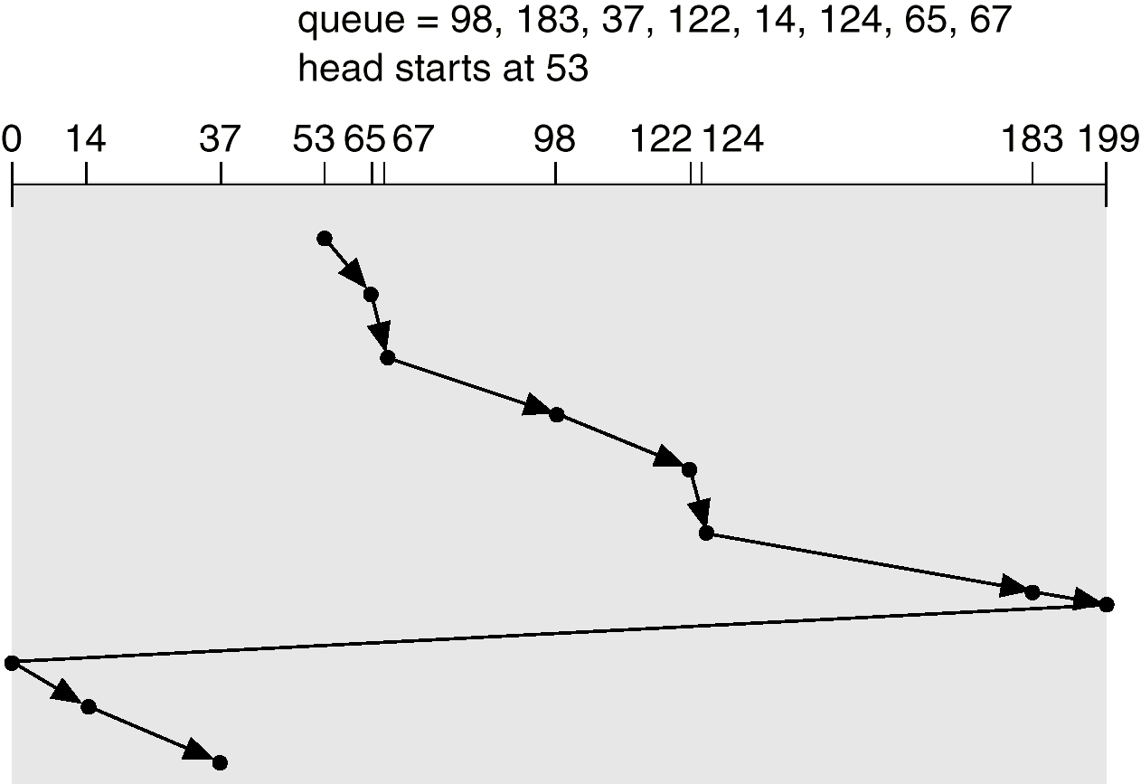
C-SCAN (Cont.)

Slide 12
C-LOOK
Version of C-SCAN
Arm only goes as far as the last request in each direction, then reverses direction immediately, without first going all the way to the end of the disk.

Slide 13
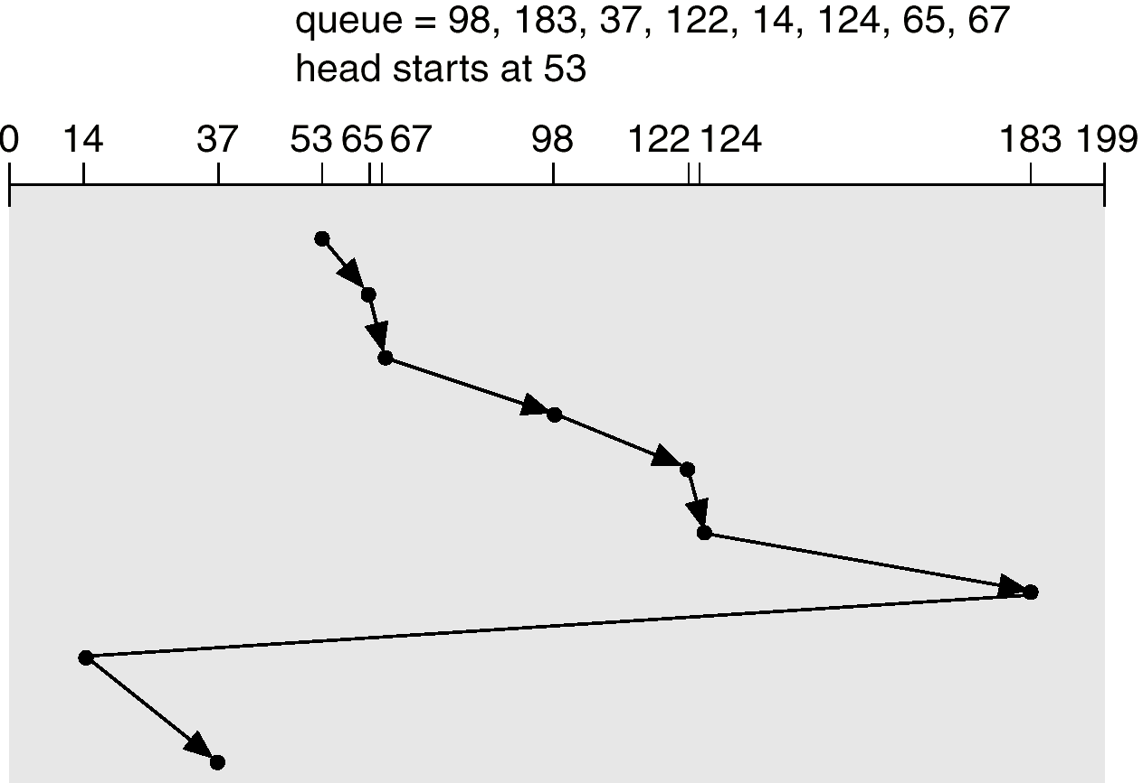
C-LOOK (Cont.)

Slide 14
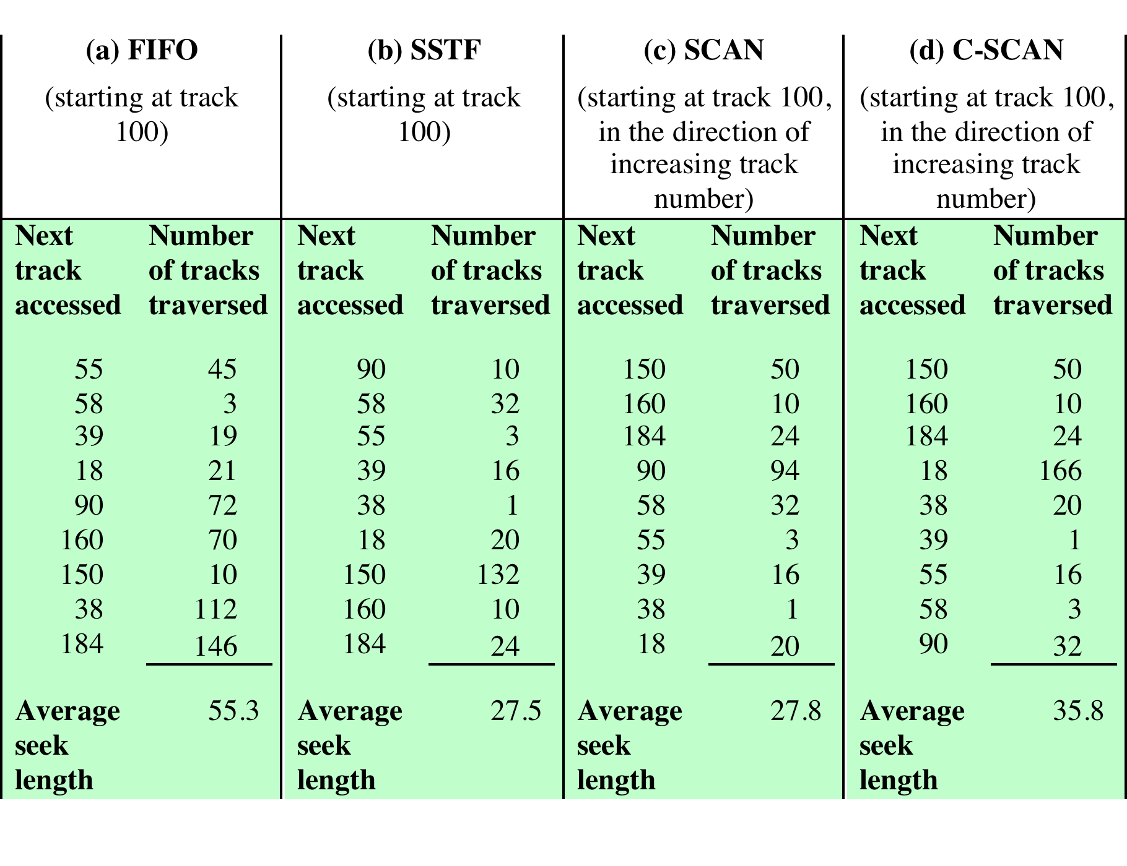
Comparison of Disk Scheduling Algorithms

Slide 15
RAID
Redundant Array of Independent Disks
Consists of seven levels, zero through six
Design architectures share three characteristics:
RAID is a set of physical disk drives viewed by the operating system as a single logical drive
data are distributed across the physical drives of an array in a scheme known as striping
redundant disk capacity is used to store parity information, which guarantees data recoverability in case of a disk failure

Slide 16
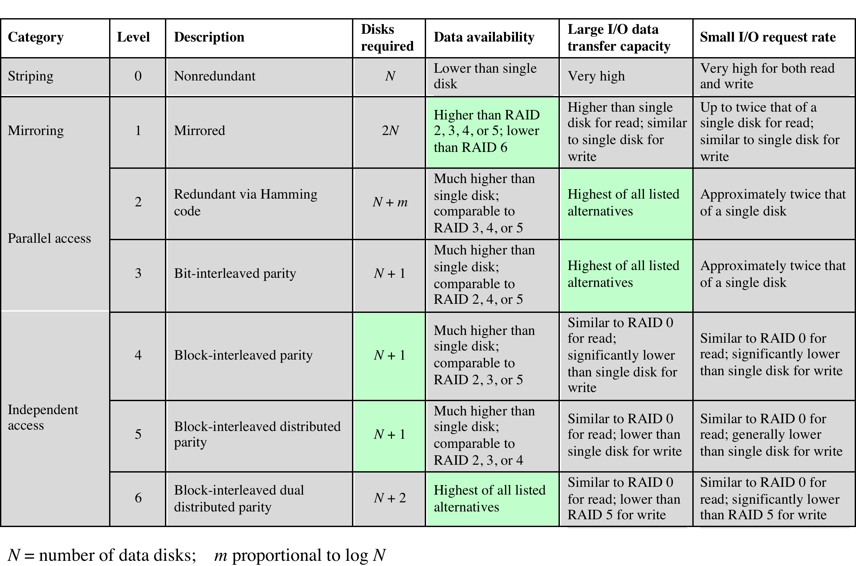
RAID Levels

Slide 17
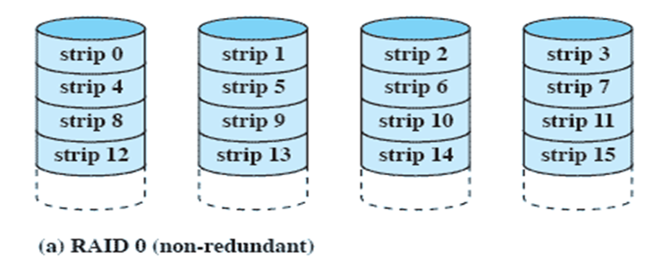
RAID Level 0
Not a true RAID because it does not include redundancy to improve performance or provide data protection
User and system data are distributed across all of the disks in the array
Logical disk is divided into strips

Slide 18
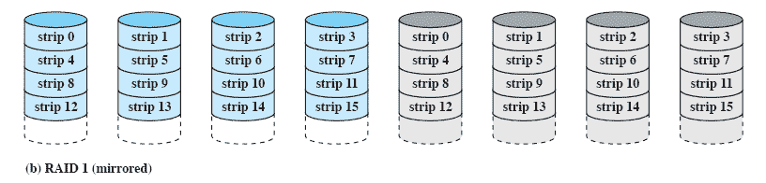
RAID Level 1
Redundancy is achieved by the simple expedient of duplicating all the data
When a drive fails the data may still be accessed from the second drive
Principal disadvantage is the cost

Slide 19
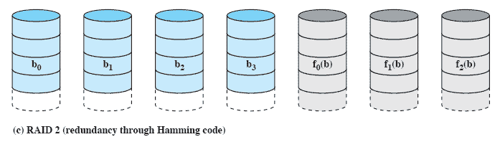
RAID Level 2
Makes use of a parallel access technique
Error correcting code is calculated. Typically a Hamming code is used
No of (redundant) disks (n)=log₂(N)

Slide 20
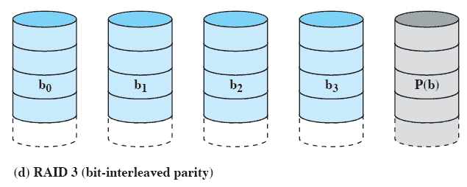
RAID Level 3
Single redundant disk, no matter how large the disk array.
Employs parallel access, Parity bit computed.
X₀ through X₃ disks contain data and X₄ is the parity disk. The parity for the i ^{th} bit is calculated as follows:
X₄(i) = X₃(i) ⊗ X₂(i) ⊗ X₁(i) ⊗ X₀(i) , where is exclusive-OR function.
Suppose that drive X₁ has failed. If we add X₄(i) ⊗ X₁(i) to both sides of the preceding equation, we get X₁(i) = X₄(i) ⊗ X₃(i) ⊗ X₂(i) ⊗ X₀(i)

Slide 21
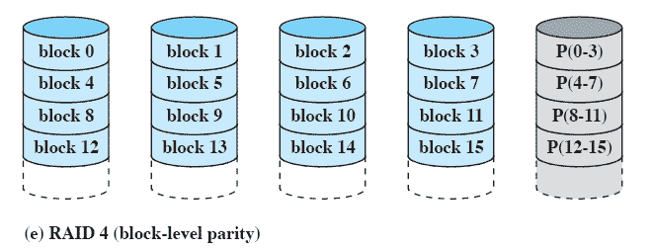
RAID Level 4
Makes use of an independent access technique
A bit-by-bit parity strip is calculated across corresponding strips on each data disk, and the parity bits are stored in the corresponding strip on the parity disk
Notes:
RAID levels 4 through 6 make use of an independent access technique. In an independent
access array, each member disk operates independently, so that separate
I/O requests can be satisfied in parallel. Because of this, independent access arrays
are more suitable for applications that require high I/O request rates and are relatively
less suited for applications that require high data transfer rates.
As in the other RAID schemes, data striping is used. In the case of RAID
4 through 6, the strips are relatively large. With RAID 4, a bit-by-bit parity strip
is calculated across corresponding strips on each data disk, and the parity bits are
stored in the corresponding strip on the parity disk.
RAID 4 involves a write penalty when an I/O write request of small size is performed.
Each time that a write occurs, the array management software must update
not only the user data but also the corresponding parity bits. Consider an array of
five drives in which X0 through X3 contain data and X4 is the parity disk. Suppose
that a write is performed that only involves a strip on disk X1. Initially, for each bit
i , we have the following relationship:
X4(i) = X3(i) X2(i) X1(i) X0(i) (11.1)
After the update, with potentially altered bits indicated by a prime symbol:
X4=(i) = X3(i) X2(i) X1=(i) X0(i)
= X3(i) X2(i) X1=(i) X0(i) X1(i) X1(i)
= X3(i) X2(i) X1 (i) X0(i) X1(i) X1=(i)
= X4(i) X1(i) X1=(i)
The preceding set of equations is derived as follows. The first line shows that
a change in X1 will also affect the parity disk X4. In the second line, we add the
terms [ X1(i) X1(i)] . Because the exclusive-OR of any quantity with itself
is 0, this does not affect the equation. However, it is a convenience that is used to
create the third line, by reordering. Finally, Equation ( 11.1 ) is used to replace the
first four terms by X4( i ).
To calculate the new parity, the array management software must read the old
user strip and the old parity strip. Then it can update these two strips with the new
data and the newly calculated parity. Thus, each strip write involves two reads and
two writes.
In the case of a larger size I/O write that involves strips on all disk drives, parity
is easily computed by calculation using only the new data bits. Thus, the parity drive
can be updated in parallel with the data drives and there are no extra reads or writes.
In any case, every write operation must involve the parity disk, which therefore
can become a bottleneck.

Slide 22
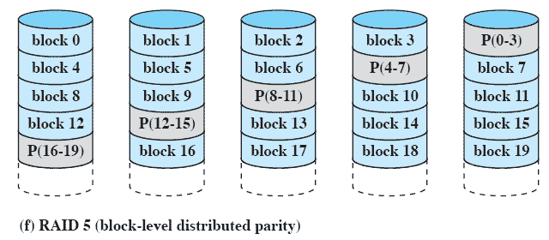
RAID Level 5
Similar to RAID-4 but distributes the parity bits across all disks
Typical allocation is a round-robin scheme
Has the characteristic that the loss of any one disk does not result in data loss
Independent access
no of disks= N+1

Slide 23
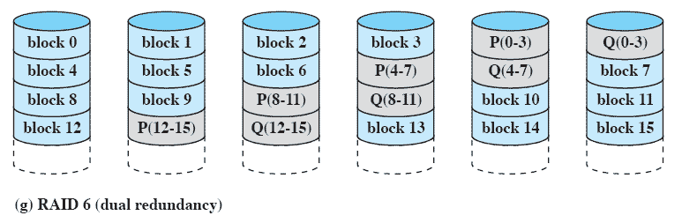
RAID Level 6
Two different parity calculations are carried out and stored in separate blocks on different disks
Provides extremely high data availability
Incurs a substantial write penalty because each write affects two parity blocks
Independent Access
No of disks = N+2

